Slide 1





KIET Group of Institutions, Ghaziabad
(An ISO– 9001: 2008 Certified & ‘A+’ Grade accredited
Institution by NAAC)
ML BASED RESUME CLASSIFIER
(Resupro)
PCS-03, Guide: Prof. Abhishek Goyal

Slide 2
ABHISHEK VERMA – 2100290120010
ADARSH MISHRA – 2100290120012
ALOK RANJAN DUBEY – 2100290120026
ANURAG KUMAR - 2100290120038
TEAM MEMBERS

Slide 3
Recruiters and hiring managers often face challenges in efficiently screening a large volume of resumes, leading to time-consuming manual processes, human biases, and potential oversight of qualified candidates. Traditional resume screening methods rely heavily on subjective judgment, making it difficult to identify the best-fit applicants for specific job roles consistently.
Moreover, many applicants fail to tailor their resumes according to job descriptions, leading to mismatches between employer expectations and candidate qualifications. This results in inefficiencies in the hiring process, prolonged recruitment cycles, and increased costs for organizations.
PROBLEM STATEMENT

Slide 4
To provide UI/UX to create a candidate’s resume.
To develop a system that automates the initial screening of resumes, reducing the time and resources spent on manual review processes.
The work aims to enhance decision-making during the early stages of recruitment by providing data insights, ultimately improving the selection process and identifying top-tier talent.
OBJECTIVES

Slide 5







Frontend
Backend
TECH STACK
ML

Slide 6
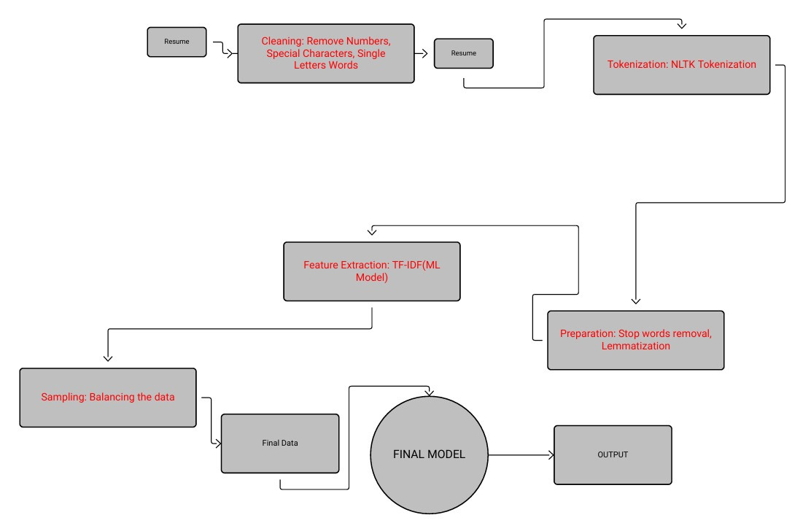
WORKFLOW

Slide 7
Resume Creation
Provide user-friendly templates for resume generation.
Ensures standardized structure for better analysis.
Input sections: Education, Skills, Experience, Projects, etc.
2. Resume Classification Process
Step 1: Input Resume
Resume can be uploaded or generated from the template.
Step 2: Text Cleaning
Remove numbers, special characters, single-letter words.
Step 3: Tokenization
Apply NLTK tokenizer to split text into tokens.
Step 4: Text Preparation
Remove stop words.
Apply lemmatization for root word conversion.
Step 5: Feature Extraction
Convert text into numerical features using TF-IDF.
Step 6: Model Training & Prediction
Train ML model and predict the resume's domain (e.g., Data Science, HR, Java Developer).
PROCESS

Slide 8
3. Resume Scoring & Comparison
Key Factors for Scoring:
Experience (in years)
Number of relevant skills
Type of companies (Product/Service-based)
Project variety and relevance
Scoring System:
Assign weights to each factor.
Generate a total score out of 100.
Comparison:
Compare candidates in the same domain.
Display ranked results or visual comparison (bar/line charts).
PROCESS

Slide 9
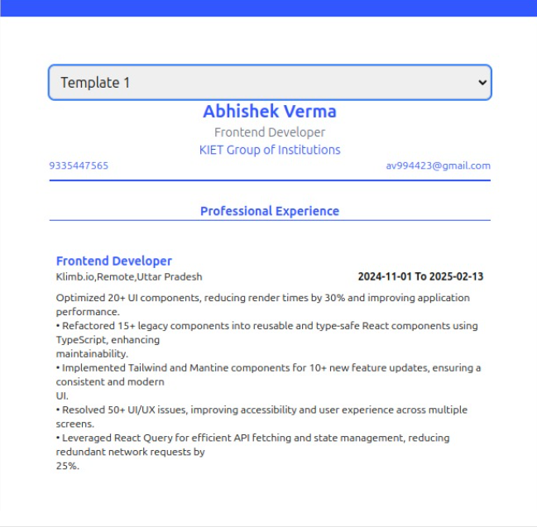
RESULTS

Slide 10
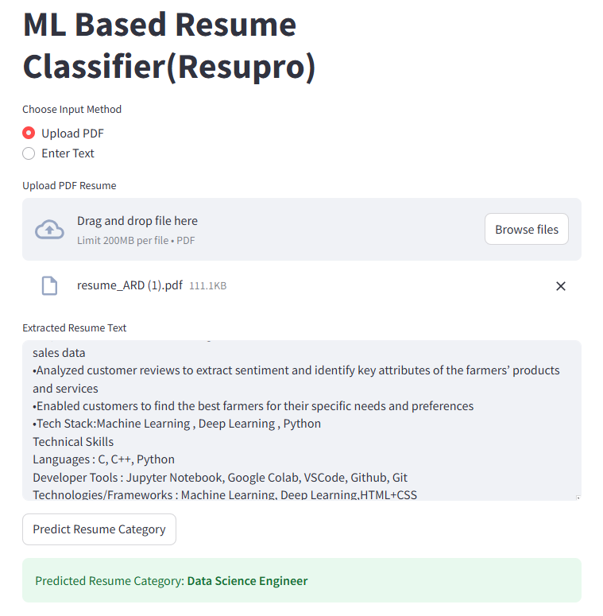
RESULTS

Slide 11
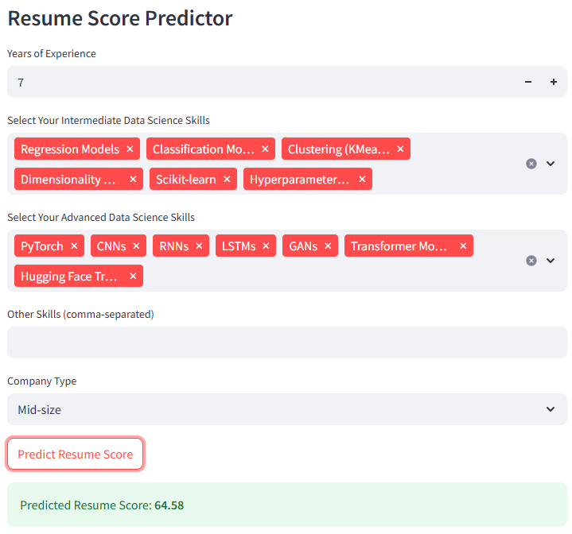
RESULTS

Slide 12
Simplified Resume Creation Users can easily generate well-structured resumes using customizable templates provided by the system. Users can download the resume in pdf format.
Accurate Domain Classification The system automatically classifies resumes into relevant job categories (e.g., Data Science, Java Developer, HR) using NLP and machine learning.
Candidate Scoring Mechanism Assigned objective scores to resumes based on experience, number of skills, and company type—enabling fair evaluation, as the scoring is domain specific.
Data-Driven Candidate Comparison Enabled side-by-side comparison of multiple candidates from the same domain, assisting recruiters in making informed decisions.
OUTCOMES

Slide 13
SDG MAPPING
SDG 4: Quality Education
Goal: Ensure inclusive and equitable quality education and promote lifelong learning opportunities for all.
Justification:
Skill-Based Resume Building – ResuPro helps job seekers create structured and domain-specific resumes, ensuring they effectively highlight their skills and qualifications, thereby improving employability.
Personalized Resume Scoring – The ML-based scoring system helps individuals understand their strengths and areas for improvement, guiding them to enhance their qualifications.
Bridging the Education-to-Employment Gap – By categorizing resumes based on skills, experience, and job roles, ResuPro supports fresh graduates and professionals in transitioning into the workforce efficiently.
SDG 17: Partnerships for the Goals
Goal: Strengthen the means of implementation and revitalize the global partnership for sustainable development.
Justification:
Collaboration with Educational Institutions – ResuPro can be integrated with universities, career counseling services, and online learning platforms to assist students in building industry-ready resumes.
Engagement with Recruiters and HR Professionals – Companies can use the platform to streamline candidate screening, enhancing hiring efficiency and diversity.
AI-Powered Job Market Insights – By analyzing large-scale resume data, ResuPro provides trends and insights into job market demands, benefiting stakeholders in education and employment.

Slide 14
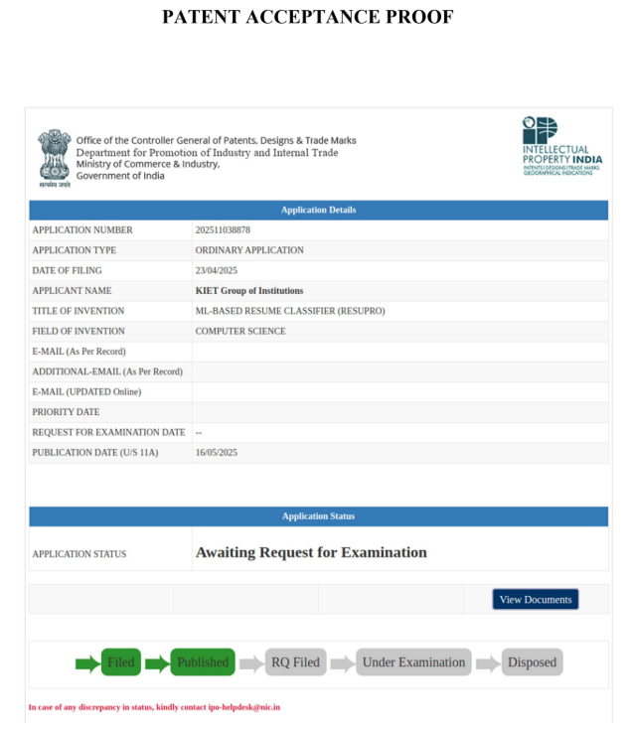
PATENT
Status: Accepted

Slide 15
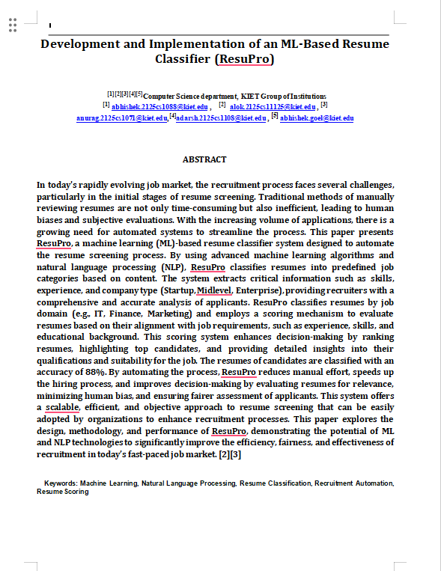
RESEARCH PAPER
Status: Submitted

Slide 16
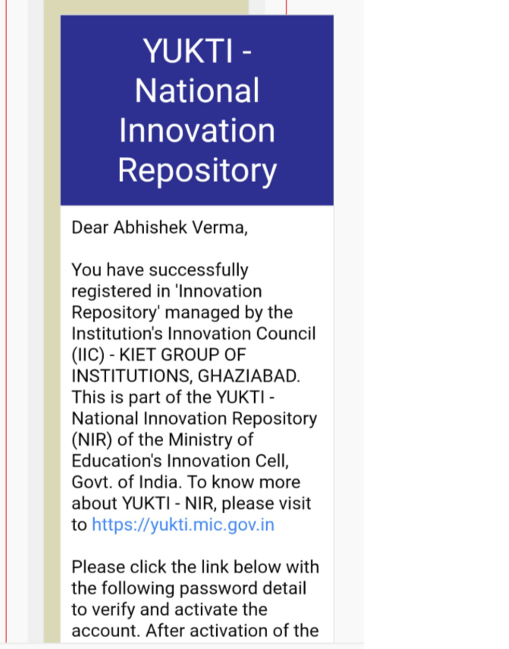
YUKTI PORTAL PROOF

Slide 17

Thank you
for attending!

